Slide 1
Used Car Price Prediction
-----------------------------------
By:
Hariprasath S

Slide 2
Problem
Statement
Data
Mining
Data Cleaning
Data Exploration
Feature Engineering
Classification Model
A problem statement is a concise and concrete summary of the research problem you seek to address.
the process of sorting through large data sets to identify patterns and relationships that can help solve business problems
the process of fixing or removing incorrect, corrupted, incorrectly formatted, duplicate, or incomplete data within a dataset
explore and visualize data to uncover insights
generate the desired variables for analysis or predictive modeling.
use to compare the relative value of different statistical models and determine which one is the best fit for the observed data.

Slide 3
Predict the price of used cars using the various Machine Learning (ML) models.
Problem
Statement

Slide 4
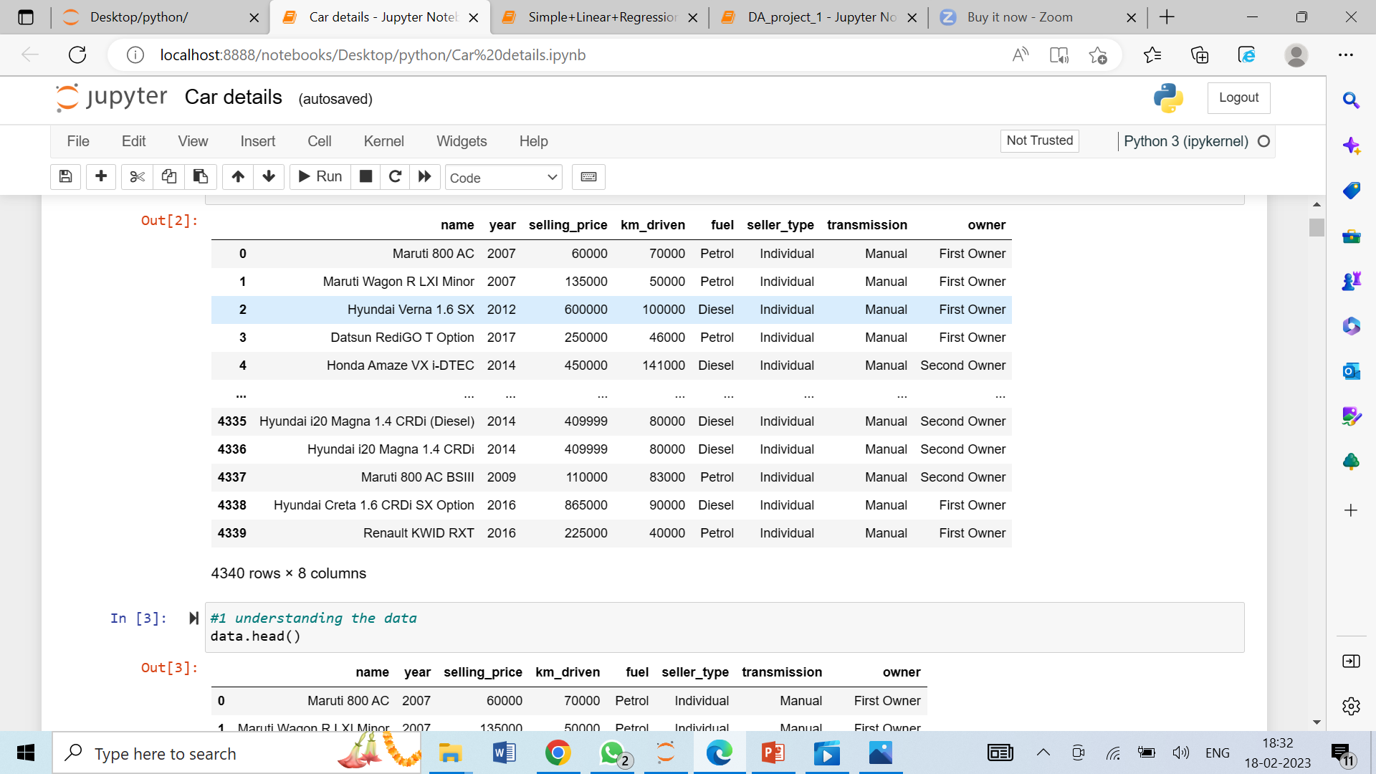
name – name of car model
selling_price – sold out price of car
year- year of the car when was it first brought.
km_driven – how much kilometer driven by car before sale
fuel- type of engine
transmission- Gearbox( manual / auto)
Owner – first owner, second owner, third owner
Data
Mining

Slide 5
There is no universal mechanism for establishing the retail price of used automobiles because different websites employ different methods to create it. By using statistical models to anticipate pricing, it is possible to obtain a preliminary price estimate without having to enter all of the details into the desired website
Gaps in
Existing System
there was fast change in car prices during this study which will affect the actual car pricing prediction future

Slide 6
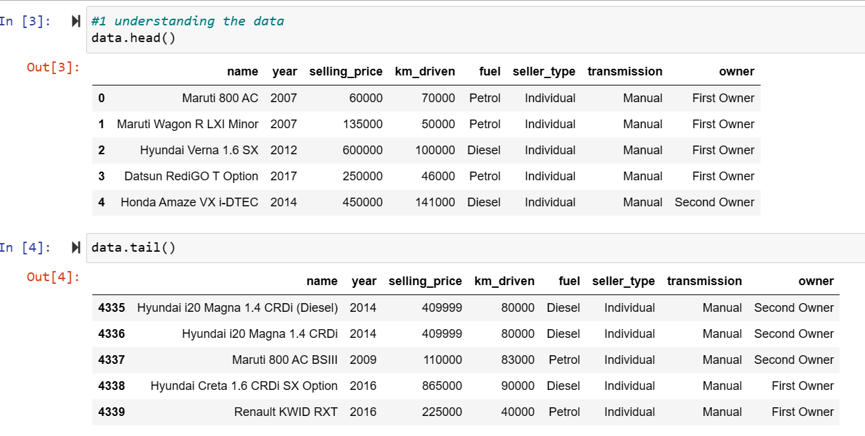
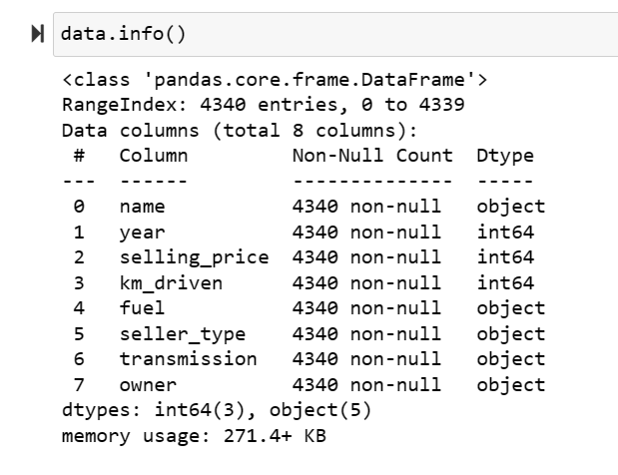
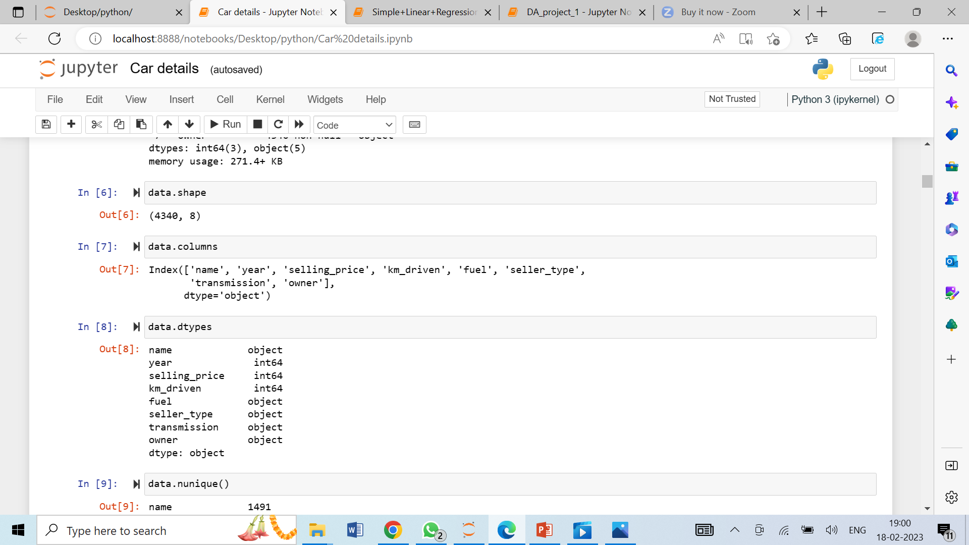
Data
Cleaning

Slide 7
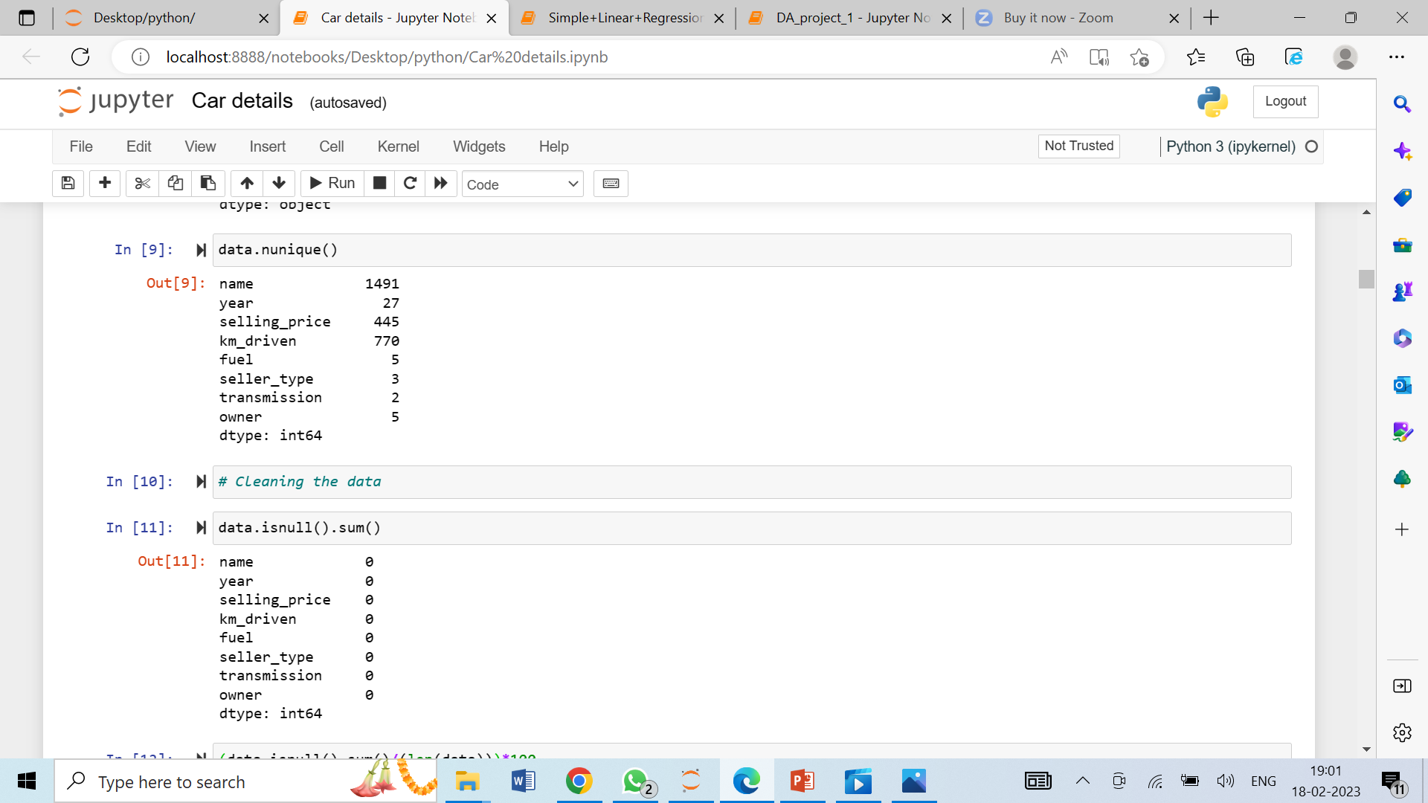
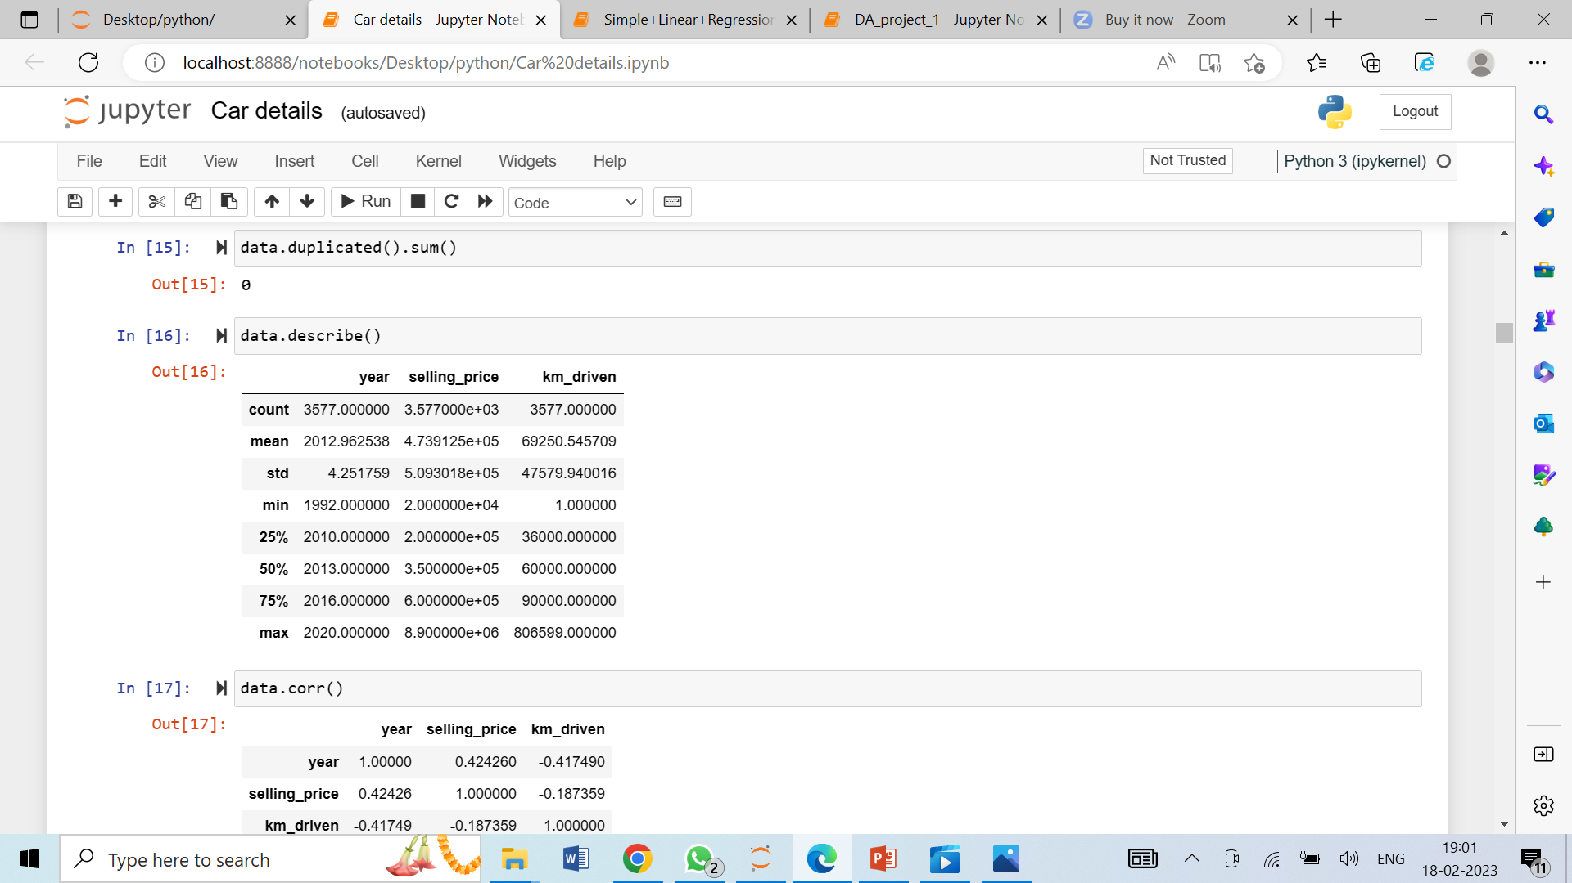
Data
Cleaning

Slide 8
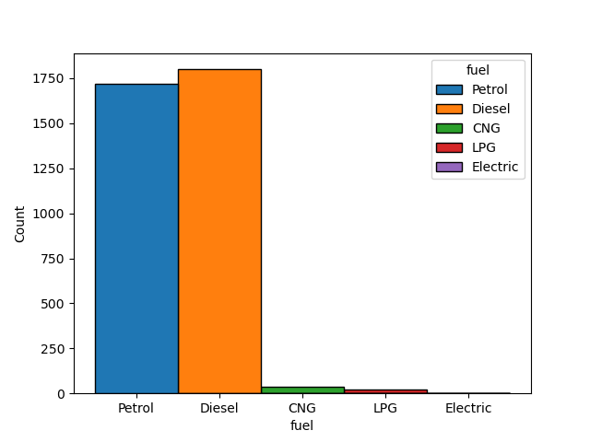
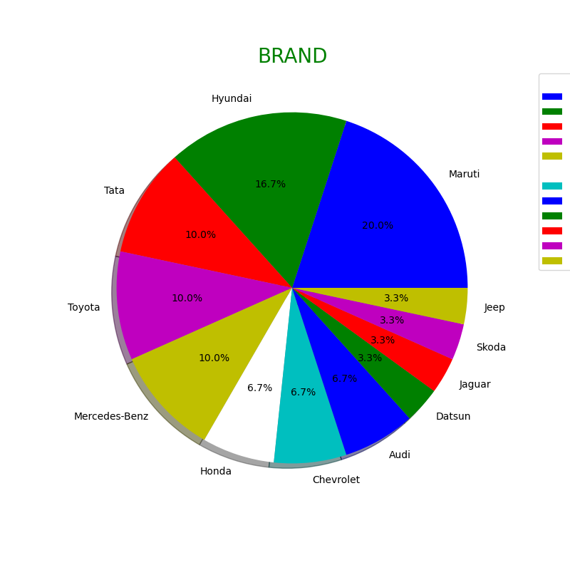
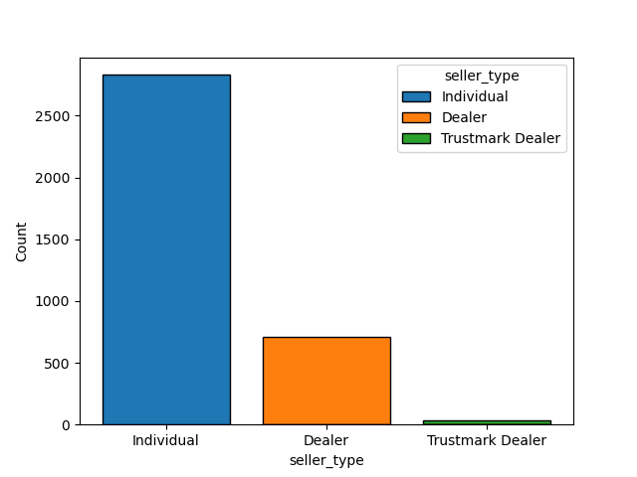
Data
Exploration

Slide 9
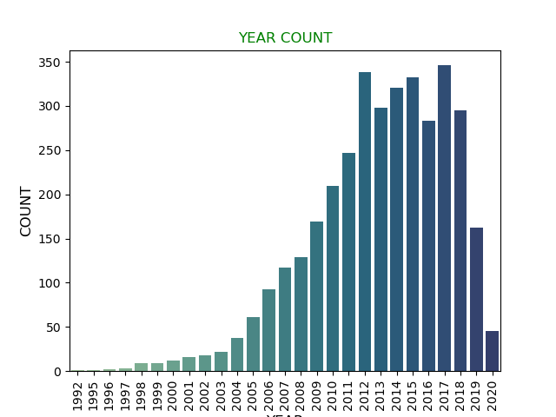
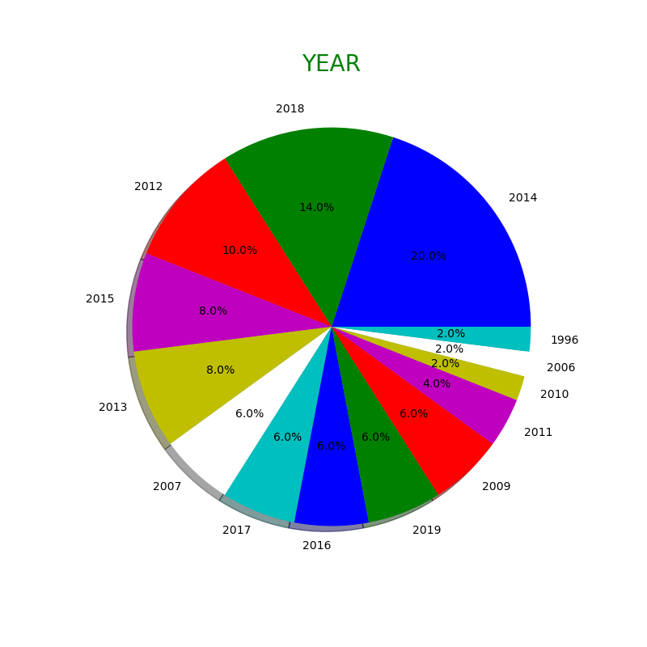
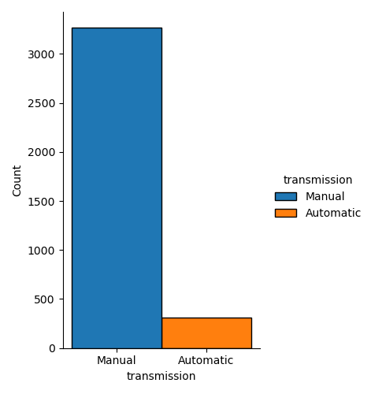
Data
Exploration

Slide 10
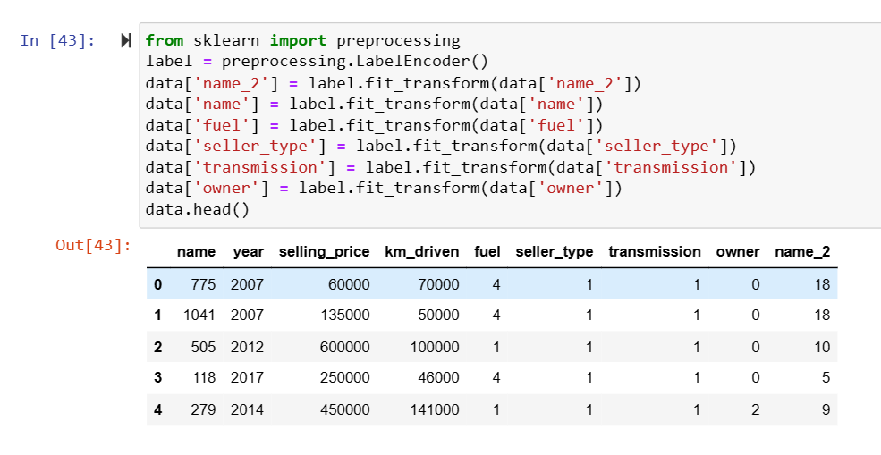
Feature
Engineering

Slide 11
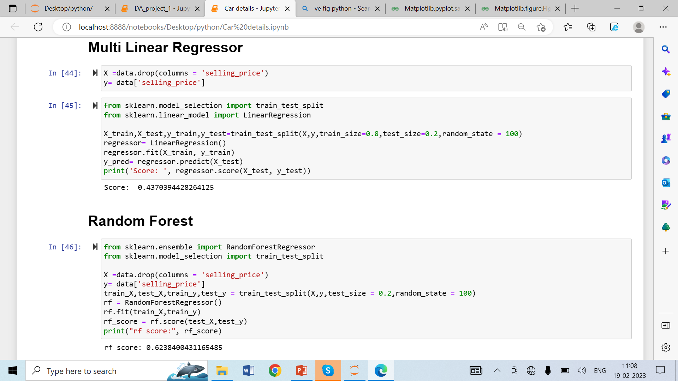
Classification Algorithm

Slide 12
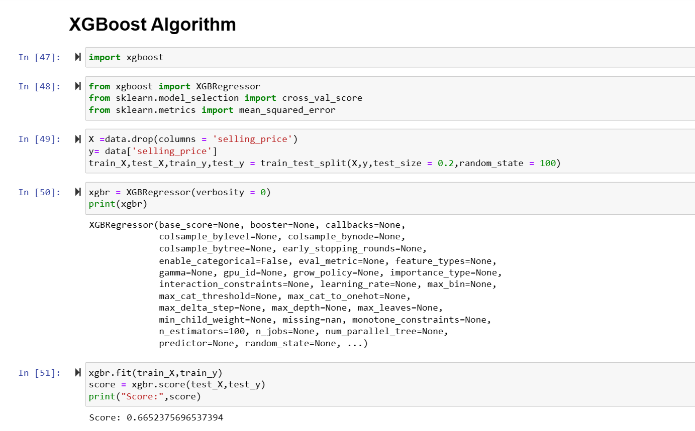
Classification Algorithm

Slide 13
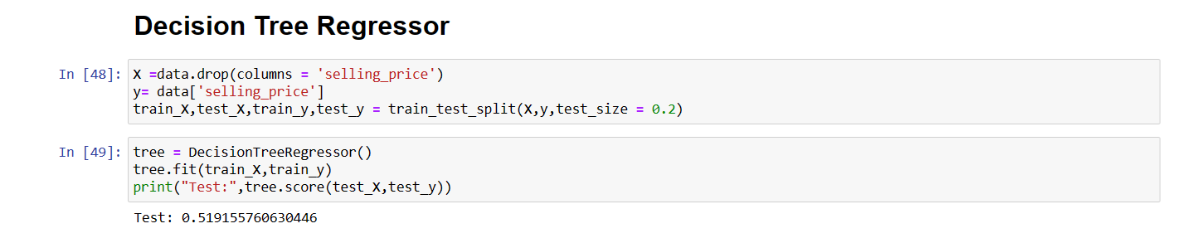
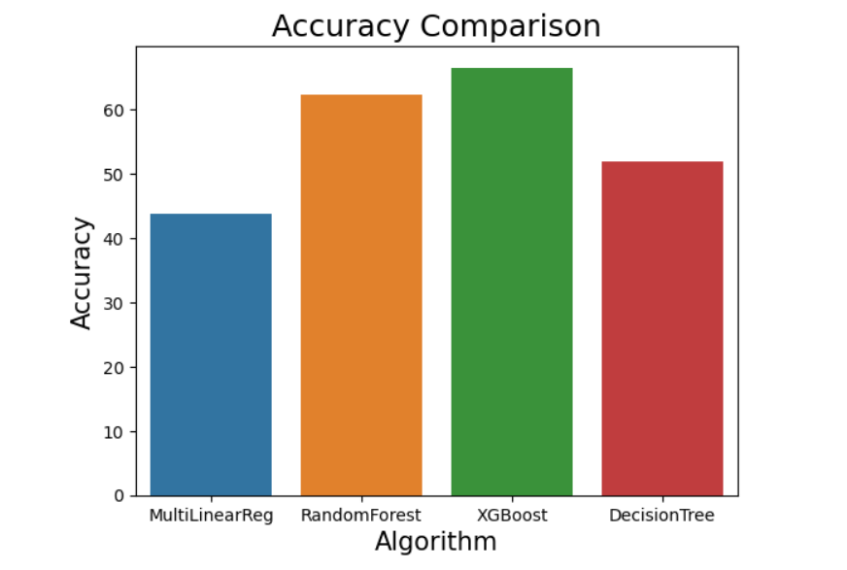
Classification Algorithm

